Slide 1
Predict HIV Progression
Course Instructor : Dr. Janet E. Burge
Team members
Akshaya Ravichandran
Ning Zhong

Slide 2
BRIEF INTRODUCTION
HIV :
Human Immunodeficiency Virus (HIV) is a virus which causes Acquired Immuno Deficiency Syndrome (AIDS) [1].
AIDS causes the immune system in human beings to fail
Predict the proliferation of HIV virus in a patient.
Check if the infection becomes less severe.

Slide 3
OUTLINE
Machine Learning algorithms employed to predict if the patient recovers or not:
1.Linear regression with one variable;
2.Linear regression with multiple variables;
3.Logistic regression; and
4. SVM algorithm
The prediction accuracy of these algorithms are compared to see which algorithm is more suitable for predicting HIV progression in human body.

Slide 4
DATASET
The Dataset is obtained from a real-life competition posted on Kaggle [2].
Contains two parts :
Training data with 1000 entries; and
Test data with 692 entries

Slide 5
FEATURES IN THE DATASET
Patient ID;
Responder status (1 if the patient recovers and 0 otherwise);
Protease nucleotide sequence (PR);
Reverse Transcriptase nucleotide sequence (RT);
Viral load at the beginning of therapy (VL); and
CD4 count at the beginning of therapy (CD4)

Slide 6
SIGNIFICANCE OF THE FEATURES
Reverse Transcriptase (RT) is an enzyme that is responsible for the replication of retroviruses like HIV [3].
Viral Load: This variable is used to determine whether a treatment is working on a patient for a given disease.
CD4 count: Higher count represents both a healthier patient and a
higher amount of HIV reproduction.
Responder Status: 1 – Patient recovers; 0 – patient doesn’t recover
Protease Sequence - Protease activity initiates virion maturation

Slide 7
APPROACH
LINEAR REGRESSION WITH ONE VARIABLE:
We use CD4 count to predict the responder status (RS) by applying linear regression algorithm on those features. After training the model with the feature CD4 count, the result is compared with the raw data, i.e., responder status and the training accuracy is calculated.
LINEAR REGRESSION WITH MULTIPLE VARIABLES:
We combine both VL and CD4 features and apply linear regression with multiple variables. By calculating the cost function and gradient descent, the probability that a person with HIV improves/does not improve is calculated using this algorithm.

Slide 8
APPROACH (contd..)
LOGISTIC REGRESSION:
By applying cost function and creating the model, we will use the prediction generated from our model and compare the results with test data to obtain the accuracy.
SVM with Gaussian Kernel:
After obtain adequate information from the model, we will predict the probability for each entry and then, compare it with raw data to get the accuracy.

Slide 9
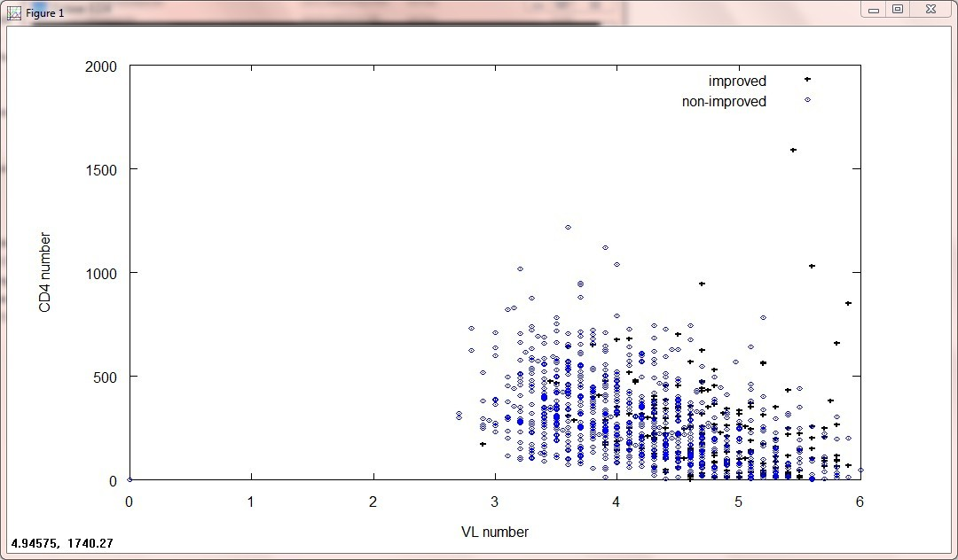
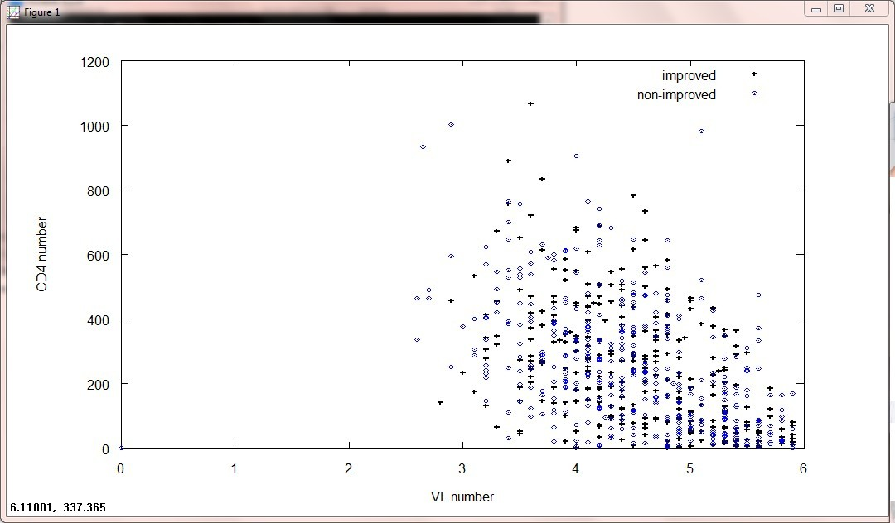
PLOTTING DATA
Training data
Test data

Slide 10
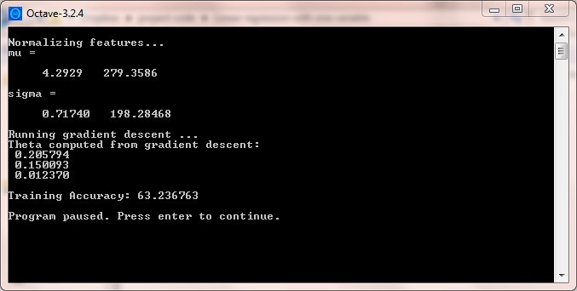
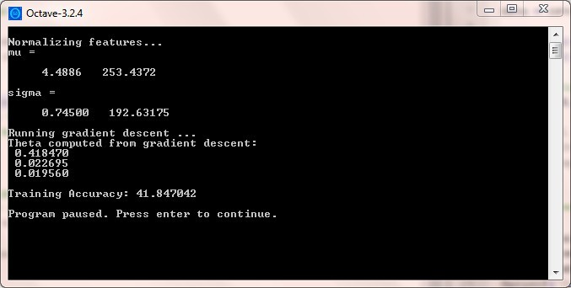
LINEAR REGRESSION WITH ONE VARIABLE (RESULTS)
Training data
Test data

Slide 11
LINEAR REGRESSION WITH MULTIPLE VARIABLES (RESULTS)
Training data
Test data

Slide 12

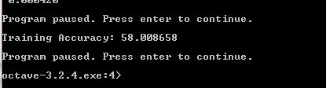
LOGISTIC REGRESSION (RESULTS)
Training data
Test data

Slide 13
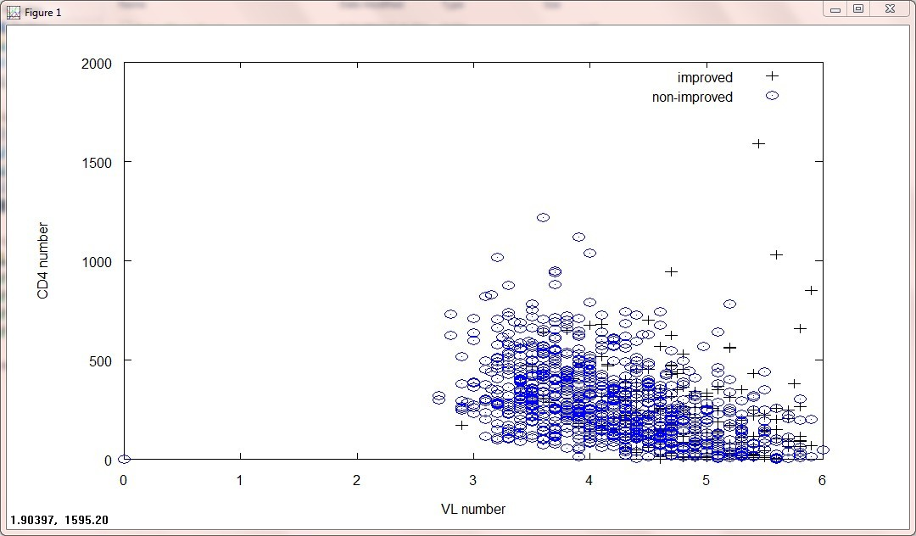
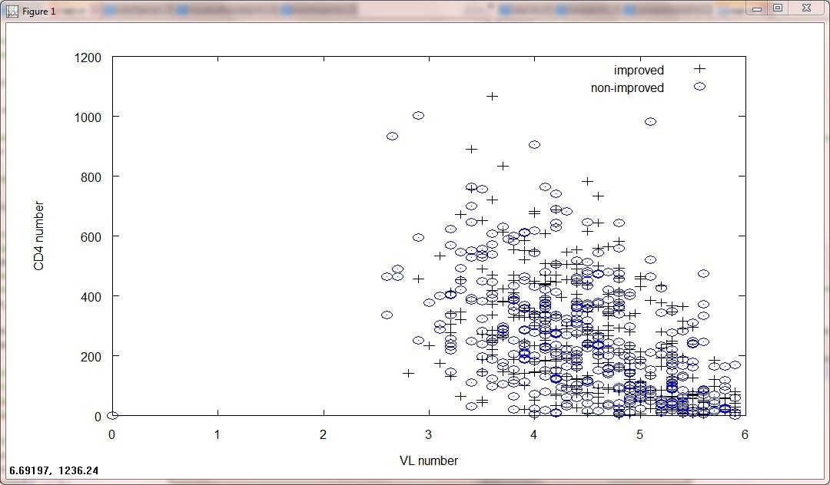
SVM with Gaussian Kernel (plotting data)
Training data
Test data

Slide 14
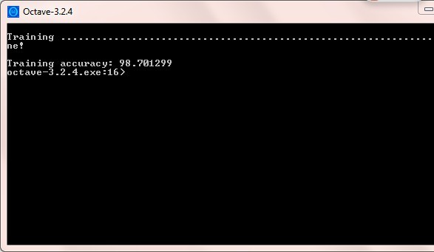
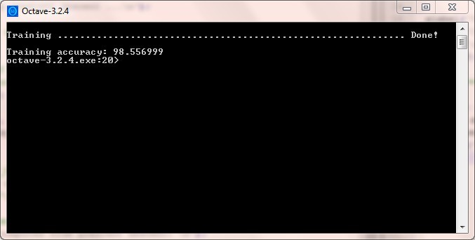
SVM with Gaussian Kernel (RESULTS)
Training data
Test data

Slide 15
INFERENCE FROM THE RESULTS
After implementing the four algorithms for predicting the progression of HIV, we found that we obtained the best training accuracy (98.70) and test accuracy(98.55) while using SVM algorithm.
Hence, we conclude that SVM algorithm with Gaussian Kernel is the best suited algorithm to predict the likelihood that the patient’s infection will become less severe.

Slide 16
CONCLUSION AND FUTURE WORK
In all the four machine learning algorithms that we have implemented, we showed better training accuracy than the existing algorithms.
It is significant to note that SVM outperforms all the existing algorithms with better training and test accuracy.
In the future, we would like to use PR and RT sequence to predict the likelihood that the patient’s infection will become less severe.

Slide 17
REFERENCES
[1] [Online] Available: http://en.wikipedia.org/wiki/HIV
[2] http://www.kaggle.com/
[3] D. Chou, R. Iu, R. Krishna, and A. Liang, “An Analysis on the Prediction of HIV Progression,” pp. 1–9, 2012.
[4] Y. Singh, N. Narsai, and M. Mars, “Applying machine learning to predict patient-specific current CD 4 cell count in order to determine the progression of human immunodeficiency virus ( HIV ) infection,” vol. 12, no. 23, pp. 3724–3730, 2013.
[5] S. Bickel, J. Bogojeska, T. Lengauer, and T. Scheffer, “Multi-task learning for HIV therapy screening,” Proc. 25th Int. Conf. Mach. Learn. - ICML ’08, vol. 1, pp. 56–63, 2008.
[6] Y. Singh and M. Mars, “Support vector machines to for

